Slide 1
The Problem
The Joint Commission (2024) excessive clinical alarms can cause alarm fatigue, where healthcare staff become desensitized and may miss critical alerts.
In a 10-bed ICU (Jan 1–31, 2023), 58,667 yellow alarms and 3,178 red alarms were recorded, showing the scale of the problem.
Interviews with 28 nurses revealed 85.7% felt overwhelmed by alarms, and many lacked proper training on alarm management.
A study by the Harvard University last year showed that nearly 5,000,000 deaths occur in India annually due to medical errors triggered by lack of practical - Business Standard Report
India’s healthcare sector saw 65,000 medical negligence cases filed in 2025 across State High Courts, the Supreme Court and the National Consumer Disputes Redressal Commission (NCDRC) -The Indian Express
ICUs generate millions of patient data points every hour
Monitors detect problems only after patient deterioration
Alarm fatigue causes doctors to ignore constant alerts
Human cognition cannot analyze complex physiological trends in real time
Team: Your Team Name | Track: HealthTech Hackathon
“In ICU, every minute matters. We give doctors hours.”

Slide 2
Our Vision
Create a machine learning engine to predict Cardiac Arrest, Septic Shock, and Hemodynamic Collapse 2–6 hours early
AI forecasts catastrophic ICU events before they occur
Predict cardiac arrest, septic shock, and blood pressure collapse

Slide 3
Solution Overview
AI Predictive Engine analyzing real-time ICU vitals('heart_rate', 'respiratory_rate', 'spo2', 'map_arterial', 'map_nibp', 'lactate’)
Explainable clinical dashboard ranking patient risk
Edge deployment ensuring hospital data privacy
Goal: transform reactive ICU care into proactive care

Slide 4
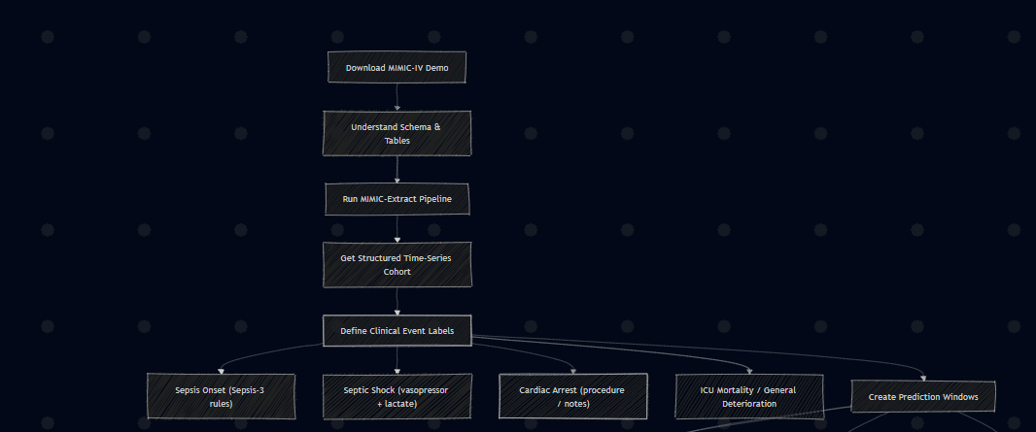

Slide 5
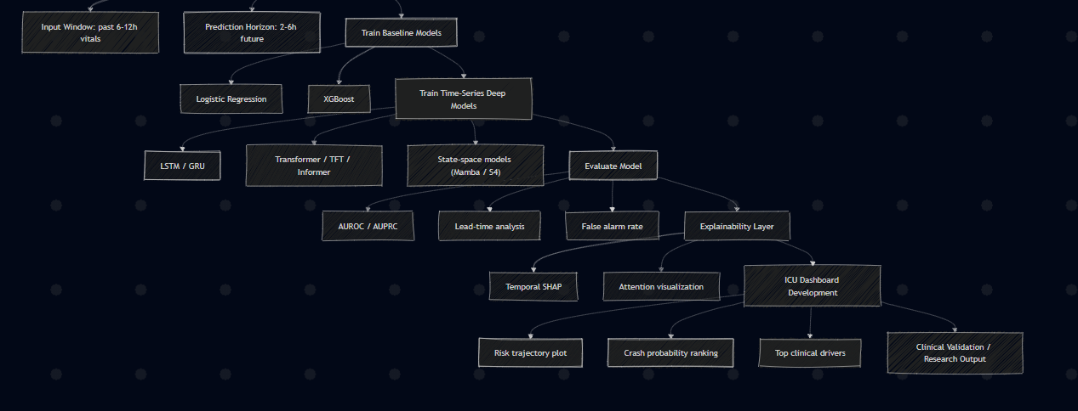

Slide 6
Dataset & Preprocessing Pipeline
Dataset Source:
We train our predictive models using the MIMIC-IV Clinical Database, a large-scale ICU dataset from Beth Israel Deaconess Medical Center containing thousands of de-identified patient records with high-resolution physiological time-series data.
Physiological Features Used
Key ICU vitals used for prediction:
• Heart Rate • Respiratory Rate • SpO₂ (Oxygen Saturation) • Mean Arterial Pressure (MAP – arterial) • MAP (Non-invasive BP) • Lactate Level (important biomarker for sepsis)
These vitals represent the patient’s physiological state over time.

Slide 7
Continue…
Sliding Window Time-Series Construction
To capture temporal patterns in patient health:
• Input Window: Past 12 hours of vitals • Prediction Gap: 6 hours buffer to prevent data leakage • Prediction Horizon: Next 6 hours
This allows the model to predict clinical deterioration 2–6 hours before the event occurs.
Clinical Events Predicted
Each window is labeled for future events:
• Sepsis (Sepsis-3 criteria) • Septic Shock • Cardiac Arrest • General ICU Deterioration
Labels are binary indicators showing whether the event occurs within the prediction horizon.

Slide 8
Clinical Events Predicted
Sepsis onset using Sepsis-3 clinical rules
Septic shock detected via vasopressors and lactate levels
Cardiac arrest detection from procedures and notes
General ICU deterioration and mortality risk

Slide 9
Baseline model
We use XGBoost Classifier and logistic regression as the baseline model due to its strong performance on structured medical data.
Key parameters:
• 100 decision trees • Max depth = 4 • Learning rate = 0.1 • Class imbalance handled using scale_pos_weight
Training uses combined training + validation datasets to improve model learning.
Dataset → Feature Windows → XGBoost Model/Logistric Regression → Calibration → Evaluation → SHAP → Saved Model
Key Outcome
The baseline training module produces clinically interpretable predictive models capable of forecasting:
Septic Shock
Sepsis
Cardiac Arrest
ICU Deterioration
2–6 hours before the event occurs with AUROC of 0.89 and AUPRC for rare medical event detection
.

Slide 10
Deep Learning Models for Temporal ICU Prediction
To capture complex physiological patterns in ICU time-series data, we employ multiple deep learning architectures optimized for sequential modeling.
Recurrent Neural Networks (Temporal Learning)
We use Long Short-Term Memory and Gated Recurrent Unit to model short-term physiological trends in patient vitals.
• Learn sequential dependencies in heart rate, BP, and oxygen levels • Capture early signals like gradual BP drop or rising HR • Maintain memory of previous patient states
Transformer Architectures (Long-Term Pattern Detection)
We apply Transformer (machine learning architecture) models to analyze long-range relationships across ICU time-series data.
Self-attention identifies correlations between multiple vitals • Detects subtle long-term deterioration patterns • Handles high-dimensional multivariate ICU signals
State-Space Models (Efficient Sequence Modeling)
Modern sequence models such as Mamba (deep learning architecture) and Structured State Space Model (S4) enable efficient processing of long patient timelines.
• Scalable for continuous ICU monitoring • Maintains stable long-term memory • Supports fast inference for real-time hospital deployment
ICU Vitals → Sliding Window → LSTM/GRU → Transformer → Ensemble → Risk Prediction

Slide 11
Model Evaluation
AUROC to measure prediction accuracy
Lead-time analysis measuring early warning capability
False alarm reduction to prevent alarm fatigue

Slide 12
Sentinel: The Problem & Solution
The Challenge in Modern Surgery
No real-time monitoring of patient vitals during surgery
No tamper-proof record – video evidence can be altered post-op
Delayed response to critical events (tachycardia, desaturation)
Our Solution: Surgical Black Box
A real-time AI-powered surveillance system that cryptographically seals every frame of surgery with patient vitals.
Key Capabilities:
Real-time vitals simulation (HR, SpO2, BP)
AI-based anomaly detection (motion, HR spikes, SpO2 drops)
SHA-256 hash chaining for tamper-proof evidence
Interactive dashboard for playback & audit

Slide 13
How It Works (3-Step Pipeline)
Sentinel Engine (sentinel_engine.py)
Processes surgical video frame-by-frame
Generates synthetic vitals with anomalies
Detects motion anomalies using frame differencing
Creates cryptographic hash chain
Audit Trail Generation
Each frame + vitals + previous hash → new SHA-256 hash
Output: telemetry.json + audit_trail.json
Interactive Dashboard
Real-time video sync with vitals
Clickable anomaly log for navigation
One-click integrity verification

Slide 14
Impact & Future Scope
This Matters
Medico-legal integrity – First tamper-proof surgical record
Patient safety – Real-time alerts prevent critical events
Training & research – Annotated replay for analysis
Technical Highlights
🔐 Cryptographic sealing per frame (SHA-256)
🤖 AI anomaly tagging with debouncing logic
📊 Real-time browser dashboard (no backend needed)
✅ Full integrity verification script
Future Scope
Integrate real medical sensors (HR monitors, pulse oximeters)
Deploy on edge devices in operating rooms
Blockchain-based distributed audit trail
ML models for surgical phase detection

Slide 15
Explainable ICU Dashboard
Patients ranked by crash probability score
Risk trajectory visualization over time
Explainable AI using Temporal SHAP values
Highlights clinical drivers triggering predictions

